Slide 1
Property & Casualty Stresses & Strategies in 2024 A Presentation for Members of DSPN
Matt Wilson, CPCU, ARM
matt.wilson@assuredparnters.com
(563) 823-7066
Cody Brickman
cody.brickman@assuredpartners.com
(563) 823-7090

Slide 2
Agenda
P&C Stresses & strategies
About AP Human Services
Insurance Market Cycles
Property
Liability
Cyber
Workers’ Compensation
Best Practices & Strategies

Slide 3
AssuredPartners- Coast to Coast

Slide 4
We’re in a “Hard” Market
Hard to get
Hard to afford
Hard to understand

Slide 5
Interactive Pricing Chart | Business Insurance News | Business Insurance

Slide 6
Commercial Property
P&C Stresses & Strategies

Slide 7
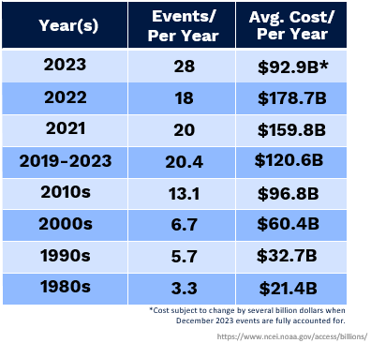
Billion Dollar Weather Events
P&C Stresses & Strategies
Hurricanes make up 59 of the 376 total events or 16.5%, but also account for $1,379B of the losses or 51.9%.
Severe storms (the most likely events in the Midwest) account for almost half of the $1B events and 17.1% of the total losses.

Slide 8
Commercial Property
P&C Stresses & Strategies
Weather Trends
Reinsurance
Interest Rates
Inflation

Slide 9
Liability
P&C Stresses & Strategies
General Liability
Automobile Liability
Errors & Omissions
Abuse/Molestation
Management Liability

Slide 10
Liability
P&C Stresses & Strategies
Social Inflation
Nuclear Verdicts
Third-Party Litigation Funders
Notes:
Social inflation: growth in liability risk costs due to changes in societal beliefs about responsibility for accidents, deterioration of previous tort reforms, legislative repeals or limitation of statutes of limitations.
Nuclear Verdicts: $10 million +. Their number have been growing.
3rd party litigation funders: groups that are willing to invest in litigation for profit.

Slide 11
Trends in Cyber Crime
Verizon 2023 Data Breach Investigations Report
https://Verizon.com/dbir

Slide 12
Cyber
Source: Are Your Passwords in the Green? (hivesystems.com)

Slide 13
Who?
Source: University of Oxford.
Image Credit: Pippa Havenhand

Slide 14
Worker’s Compensation
P&C Stresses & Strategies
Lower Frequency of Injuries
Multi-Year Rate Decreases
Limited Impact of COVID Claims
Increased Competition

Slide 15
Worker’s Compensation
P&C Stresses & Strategies

Slide 16
Property Strategies
P&C Stresses & Strategies
Diligent Preventative Maintenance
Push Back
Alternative Valuation
Alternative Deductibles
Marketing – Cautiously
Think Ahead

Slide 17
Liability Strategies
P&C Stresses & Strategies
Multi-State Background Checks
Strong Written Policies & Procedures
Recurring Training
Strict Adherence

Slide 18
Cyber Strategies
P&C Stresses & Strategies
Password Protection
End-Point Protection
Multi-Factor Authentication
Strong protocols for Remote Access
User Education
Software Security Updates
Professional Help
System Scans

Slide 19
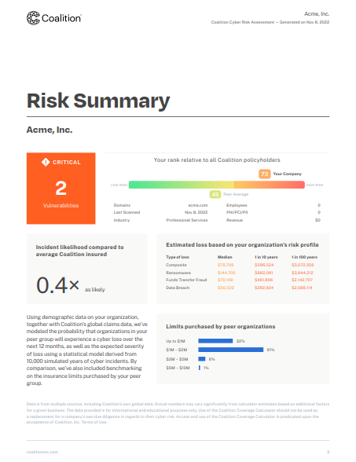
System Scans
System
Scans

Slide 20
Workers’ Comp. Strategies
P&C Stresses & Strategies
Top Management Commitment to Safety
Proactive Insurer Relationship
Incident and Accident Review

Slide 21
Thank you
Matt Wilson
matt.wilson@assuredpartners.com
(563) 823-7066
assuredpartners.com
Cody Brickman
cody.brickman@assuredpartners.com
(563) 823-7090
assuredpartners.com

